Slide 1

E-Commerce Marketing
E C O M M E R C E
A picture is worth a thousand words

Slide 2

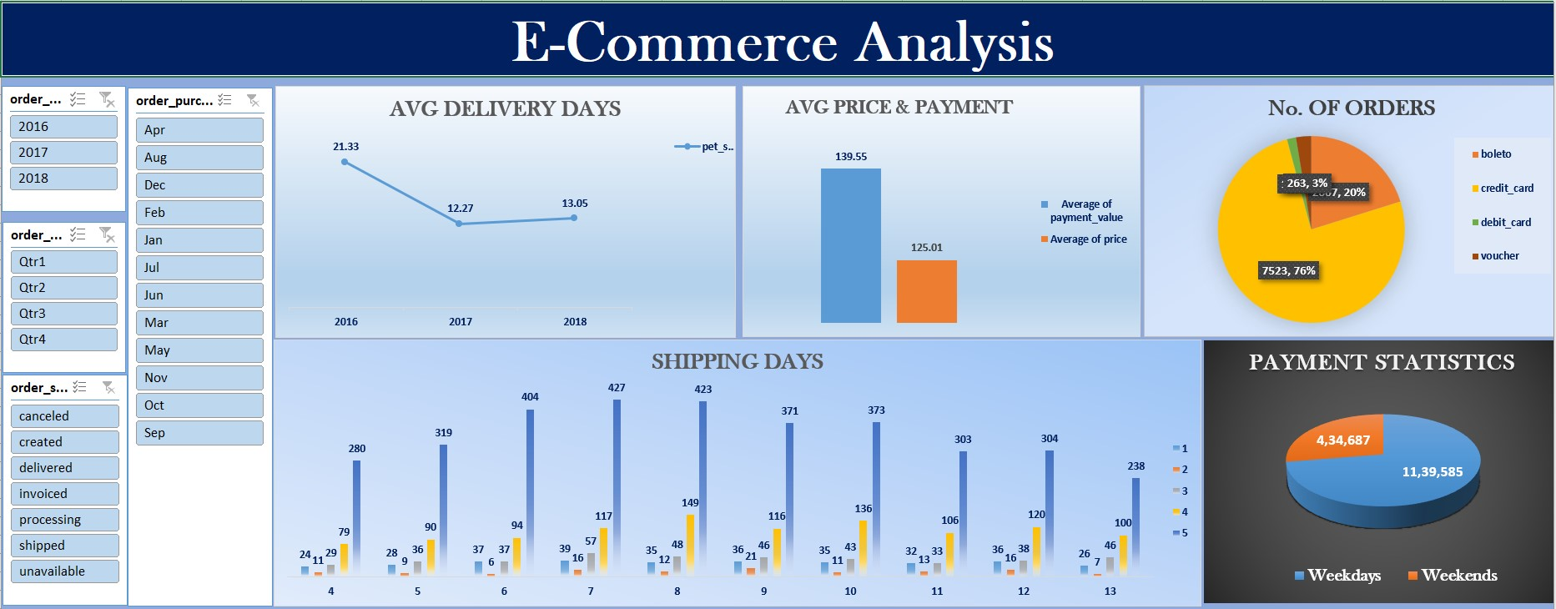
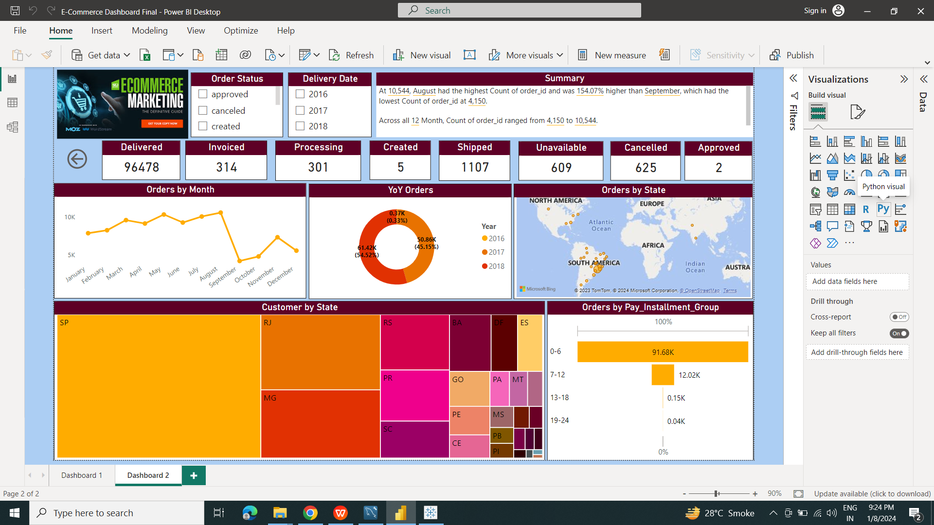
Dashboard
E C O M M E R C E

Slide 3
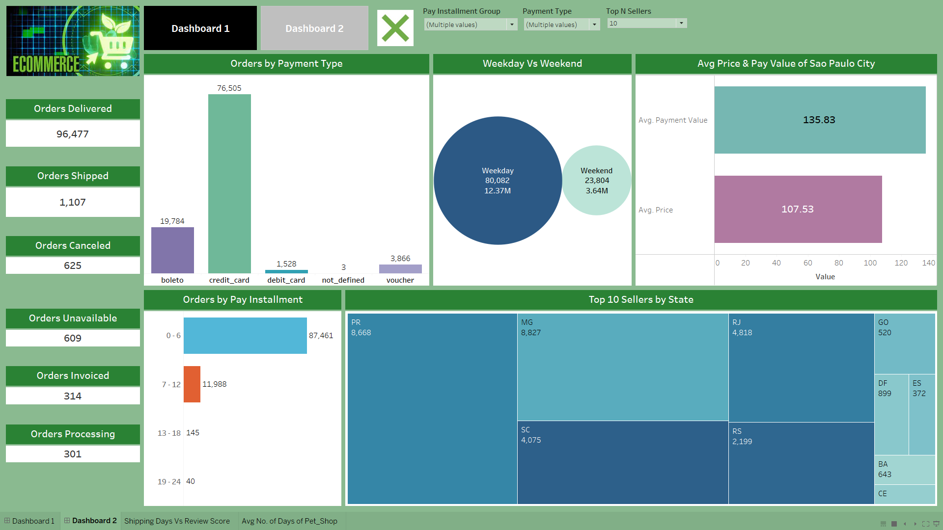
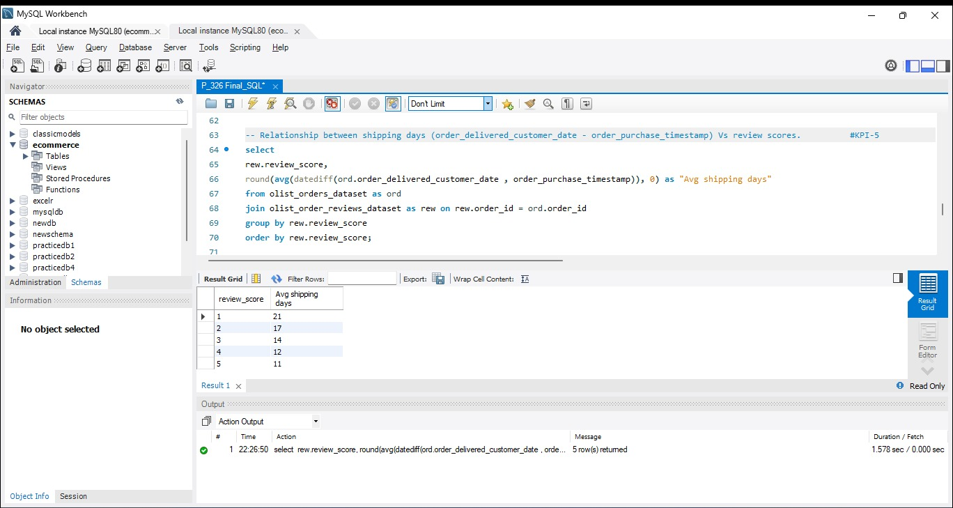
Dashboard
E C O M M E R C E

Slide 4



Weekday Vs Weekend Payment Statistics
E C O M M E R C E
Day of the Week with Highest Sales
Online Payment Preferences

Slide 5
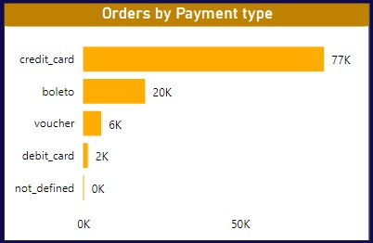
Number of Orders with review score 5 and payment type as credit card
Customer Satisfaction Levels
Payment Preferences
Repeat Purchase Opportunities
E C O M M E R C E

Slide 6
Average number of days taken for order_delivered_customer_date for pet_shop
Customer Satisfaction Impact
Optimizing Logistics and Fulfilment
Delivery Time Efficiency
E C O M M E R C E

Slide 7
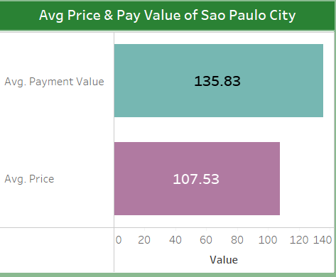
Average price and payment values from customers of sao paulo city
E C O M M E R C E
Identification of High-Value Customers
Personalized Offerings
Enhanced Customer Experience

Slide 8
Relationship between shipping days Vs review scores
E C O M M E R C E
Customer Satisfaction Correlation
Identifying Optimal Shipping Times
Operational Efficiency and Logistics Optimization
Continuous Improvement Strategies

Slide 9
Conclusion
Providing a proper shipment tracking system aids in having clear and concise communication between customers, sellers and couriers.
Regular updates can set proper expectations among customers and specific delivery instructions of customers can be properly accommodated.
By establishing trust and communication, both parties can work together to resolve any issues that may arise.
E C O M M E R C E

Slide 10
Recommendations
Regularly monitor and analyse customer reviews to gain insights in product quality and identify areas for improvement.
Identify patterns in customer reviews. This will provide a data-driven approach to enhance customer experience.
Investigate delivery delays and undelivered orders.
Analyse geographic locations could bring insights about certain challenges with demographics, accessibility, and possible route optimization.
E C O M M E R C E

Slide 11
E C O M M E R C E
THANKS FOR WATCHING

